Slide 1
MACHINE LEARNING PROJECTS
Project 1 - Heart Disease Prediction
Project 2 - College Clustering
-
-By Hrutika Badgeri & Nishant Shenoy

Slide 2
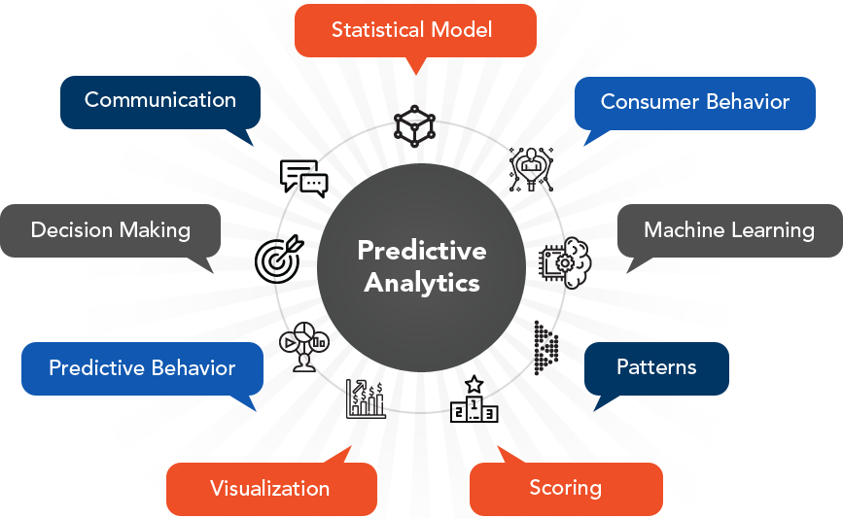
Machine Learning - Predictive Analytics
Both machine learning and predictive analytics are used to make predictions on a set of data about the future. Predictive analytics uses predictive modelling, which can include machine learning. Predictive analytics has a very specific purpose: to use historical data to predict the likelihood of a future outcome

Slide 3
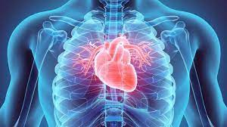
PROJECT 01 - HEART DISEASE PREDICTION
Machine Learning is used across many spheres around the world including the healthcare industry. Machine Learning can play an essential role in predicting presence/absence of Heart diseases and more. Such information, if predicted well in advance, can provide important insights to doctors who can then adapt their diagnosis and treatment per patient basis.

Slide 4
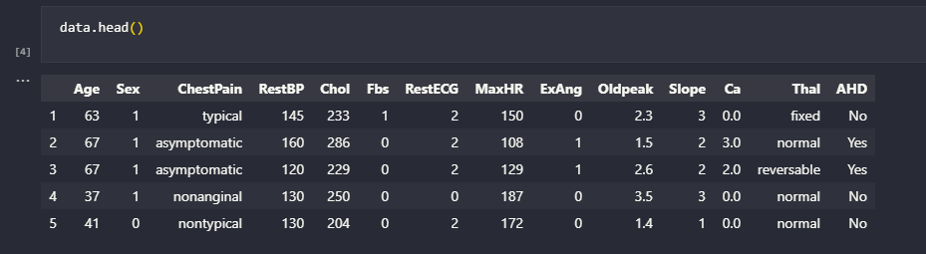
DATA SET
Task: Binary Classification
Total data points and attributes: 303 rows and 14 columns

Slide 5
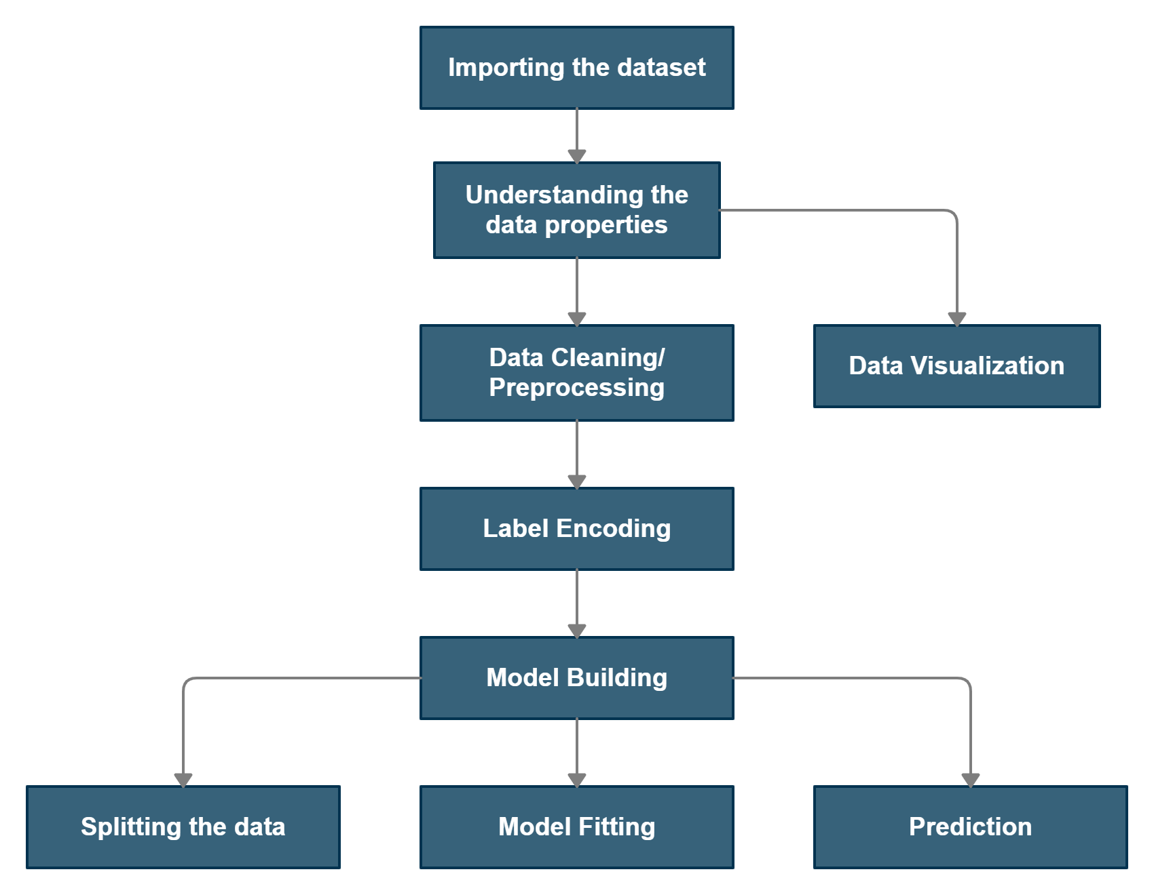
IMPLEMENTATION

Slide 6
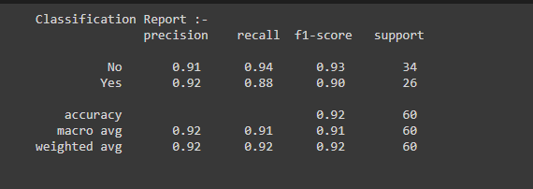
RESULTS AND ACCURACY

Slide 7
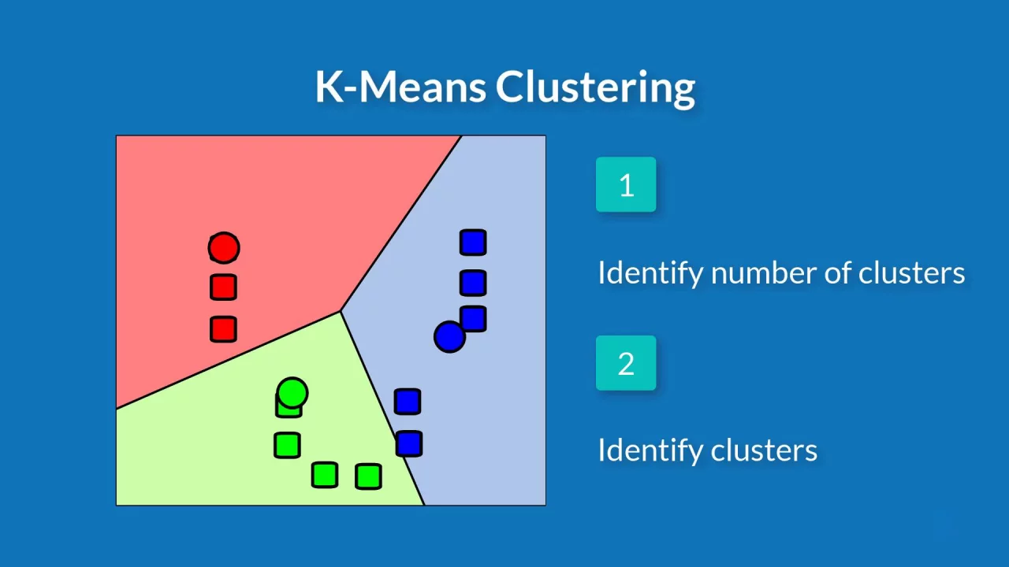
Machine Learning - Cluster Analytics
Clustering or cluster analysis is a machine learning technique, which groups the unlabelled dataset. It can be defined as "A way of grouping the data points into different clusters, consisting of similar data points.

Slide 8
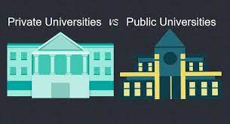
PROJECT 02 - COLLEGE CLUSTERING
Given the dataset for different colleges with certain attributes such as total enrollments, student-faculty ratio, graduation programs etc. we’ve to cluster the data into which category of college does it belong to i.e whether the particular college is a private or a public college.

Slide 9
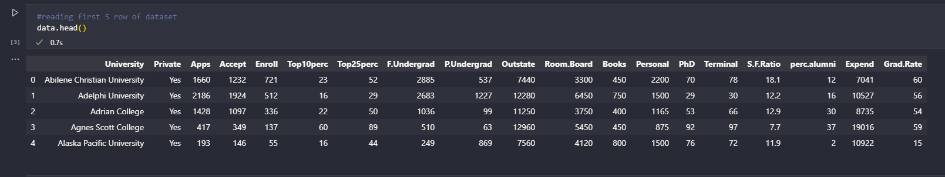
DATA SET
Task: Clustering
Total data points and attributes: 777 rows and 19 columns

Slide 10
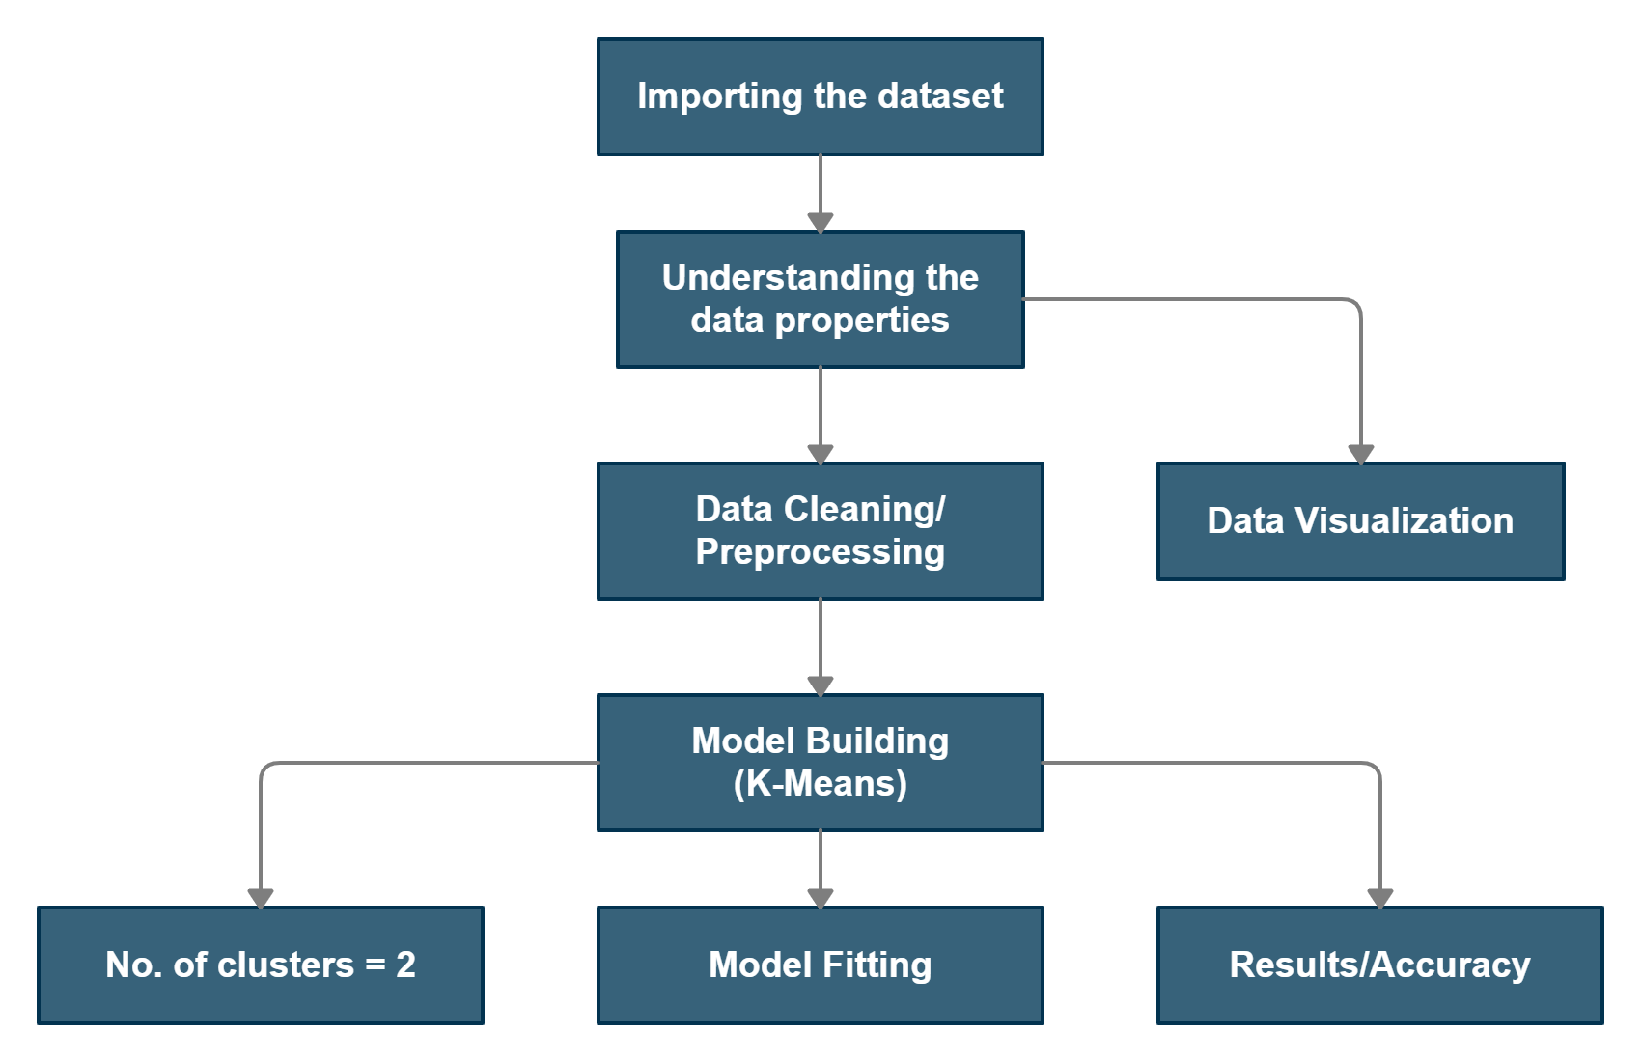
STEPS

Slide 11
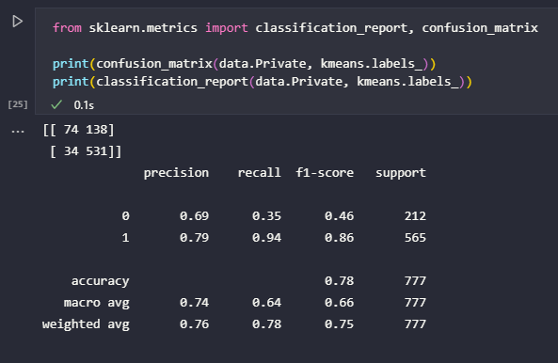
RESULTS

Slide 12
THANK YOU.

